Slide 1

Advanced Topics in Economic Evaluation and Healthcare
Lecture #7: Probabilistic Sensitivity Analysis

Slide 2
Lecture Overview
In this lecture we will discuss:
  The main ideas behind probabilistic sensitivity analysis.
  Problems with ICERs and the Solution: Net Monetary Benefits and Net Health Benefits.
  The Cost Effectiveness Acceptability Curve.
  Sketching the CEAC by hand.
  A crash course in probability distributions (or the just ones we need)
  Conducting a probabilistic Sensitivity Analysis in Excel.
By the end of this lecture you will understand how to interpret and conduct a probabilistic sensitivity analys

Slide 3
Probabilistic Sensitivity Analysis
In Probabalistic Sensitivity Analysis, we vary all the parameters at the same time.
This is done by drawing model parameters from predefined distributions and computing the model many times.
In each draw a new valuation of costs, effects and the ICER is computed.
The idea behind PSA is that it wants to consider all possible outcomes which may be simulated from a model.

Slide 4


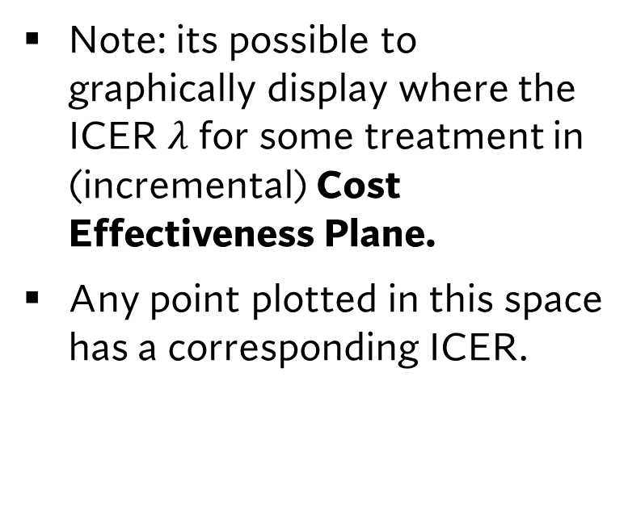



The cost effectiveness plane and the ICER
$$ΔC$$
Note: its possible to graphically display where the ICER $λ$ for some treatment in (incremental) Cost Effectiveness Plane.
Any point plotted in this space has a corresponding ICER.
$$ΔC^{A}$$
$$λ^{A}=ΔC^{A}/ΔE^{A}$$
0
0
$$ΔE^{A}$$
$$ΔE$$

Slide 5
PSA and the CE Plane
$$ΔC$$
When a probabilistic sensitivity analysis is conducted, we compute many different ICERs.
Typically, analysts run 10,000 simulations to get a rough sense of all possible outcomes.
$$ΔE$$

Slide 6
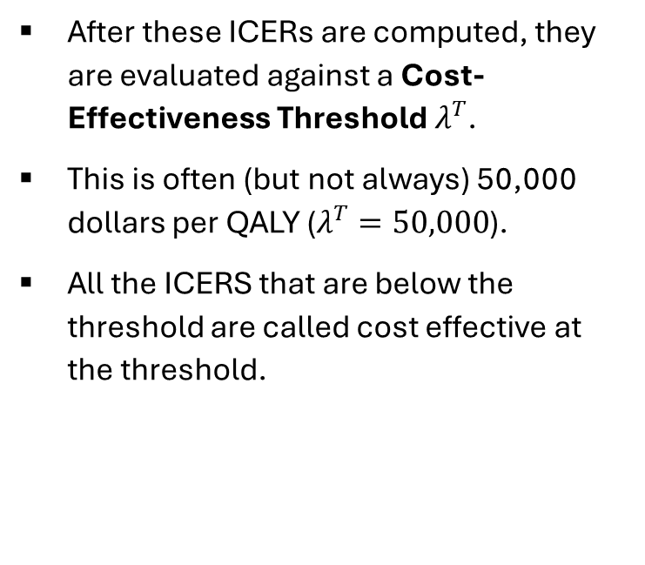

PSA and the CE Plane
$$ΔC$$
$$λ^{T}$$
After these ICERs are computed, they are evaluated against a Cost-Effectiveness Threshold $λ^{T}$.
This is often (but not always) 50,000 dollars per QALY ($λ^{T}=50,000$).
All the ICERS that are below the threshold are called cost effective at the threshold.
$$ΔE$$

Slide 7
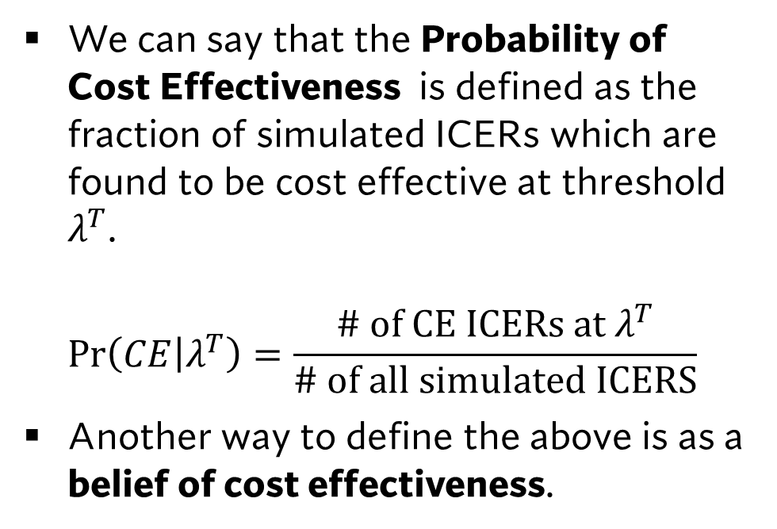
PSA and the CE Plane
$$ΔC$$
$$λ^{T}$$
We can say that the Probability of Cost Effectiveness is defined as the fraction of simulated ICERs which are found to be cost effective at threshold $λ^{T}$.
$\operatorname{Pr}\left(CE | λ^{T}\right)=\frac{\# of CE ICERs at λ^{T}}{\# of all simulated ICERS}$
Another way to define the above is as a belief of cost effectiveness.
$$ΔE$$

Slide 8
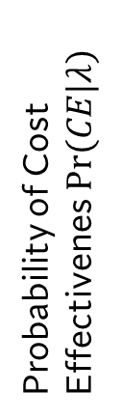

The Cost Effectiveness Acceptability Curve.
We can take probabilistic sensitivity analysis further with the use of the Cost Effectiveness Acceptability Curve.
This curve tells us the probability of cost effectiveness over a range of threshold values.
1
CEAC
Probability of Cost Effectivenes $Pr(CE|λ)$
0
Threshold Value $λ$

Slide 9
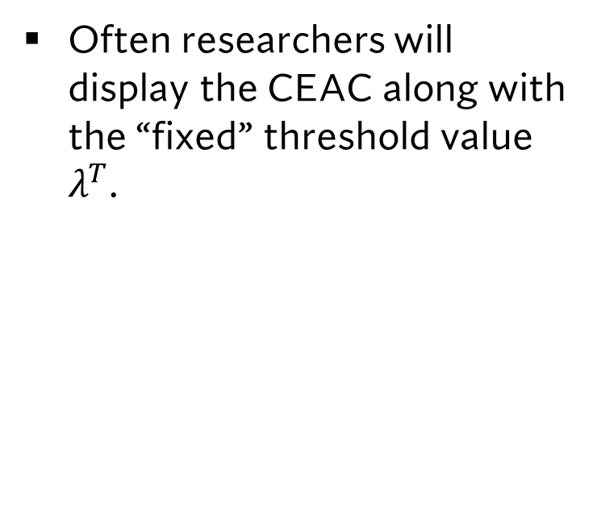

The Cost Effectiveness Acceptability Curve.
Often researchers will display the CEAC along with the “fixed” threshold value $λ^{T}$.
$$λ^{T}$$
1
CEAC
Probability of Cost Effectivenes $Pr(CE|λ)$
0
Threshold Value $λ$

Slide 10
Net Monetary Benefits and Net Health Benefits

Slide 11


The cost effectiveness plane and the ICER
$$ΔC$$
More Costly, Less Effective
(Never Cost Effective)
More Costly, More Effective
(Can be cost effective)
The Cost effectiveness plane can be divided into 4 quadrants.
We can easily interpret an ICER in each of these quadrants.
Two important quadrants are the 2nd and 4th quadrant where regardless of threshold value a ICER will be cost effective or not.
0
Less Costly, Less Effective (Can be cost effective)
0
$$ΔE$$
Less Costly, More Effective
(Always Cost Effective)

Slide 12
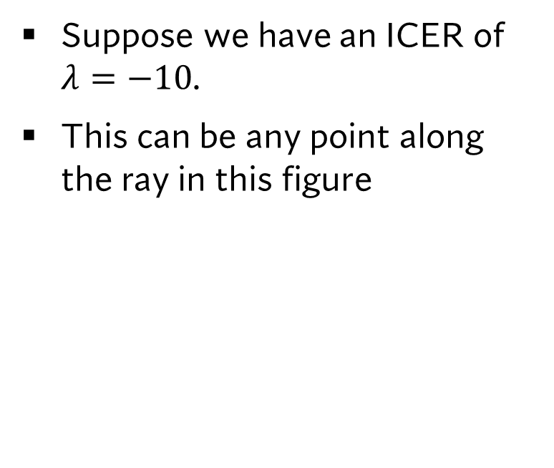
The Problem with Negative ICERs
Suppose we have an ICER of $λ=−10$.
This can be any point along the ray in this figure
$$ΔC$$
$$ΔE$$

Slide 13
The Problem with Negative ICERs
The problem here is that this ICER can correspond to treatments that are less costly and more effective and treatments that are more costly and less effective.
These are very different results!
Given this fact, how can we practically compute the CEAC?
$$ΔC$$
More Costly
Less Effective
$$ΔE$$
Less Costly,
More Effective

Slide 14
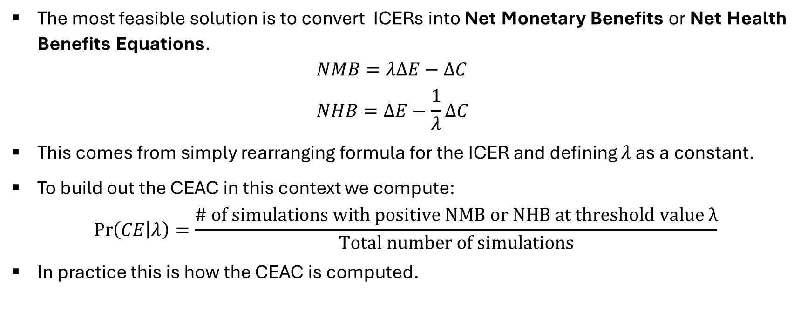
The Solution: Net Health Benefits and Net Monetary Benefits
The most feasible solution is to convert ICERs into Net Monetary Benefits or Net Health Benefits Equations.
$NMB=λΔE−ΔC$
$NHB=ΔE−\frac{1}{λ}ΔC$
This comes from simply rearranging formula for the ICER and defining $λ$ as a constant.
To build out the CEAC in this context we compute:
$\operatorname{Pr}\left(CE | λ\right)=\frac{\# of simulations with positive NMB or NHB at threshold value λ}{Total number of simulations}$
In practice this is how the CEAC is computed.

Slide 15
Sketching the CEAC by hand

Slide 16





Sketching the CEAC by hand.
Consider the following CE plane with 100 simulated ICERS. Sketch the cost effectiveness acceptability curve
$$ΔC$$
N=10
N=50
$$Pr⁡(CE|λ)$$
$$ΔE$$
N=30
N=10
$$0$$
$$λ^{T}$$

Slide 17
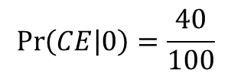



Sketching the CEAC by hand.
Consider the following CE plane with 100 simulated ICERS. Sketch the cost effectiveness acceptability curve
$$ΔC$$
N=10
N=50
$$Pr⁡(CE|λ)$$
$$ΔE$$
$$0.4$$
N=30
N=10
$$λ^{T}=0$$
$$\operatorname{Pr}\left(CE | 0\right)=\frac{40}{100}$$
$$0$$
$$λ$$
Step 1: Compute the probability of cost effectiveness at $λ=0$

Slide 18
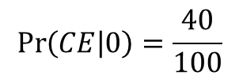

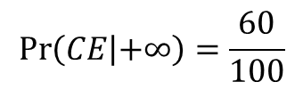

Sketching the CEAC by hand.
Consider the following CE plane with 100 simulated ICERS. Sketch the cost effectiveness acceptability curve
$$ΔC$$
$$λ^{T}=+∞$$
N=10
N=50
$$Pr⁡(CE|λ)$$
$$0.6$$
$$\operatorname{Pr}\left(CE | +∞\right)=\frac{60}{100}$$
$$ΔE$$
$$0.4$$
N=30
N=10
$$\operatorname{Pr}\left(CE | 0\right)=\frac{40}{100}$$
$$0$$
$$λ$$
Step 2: Compute the probability of cost effectiveness at $λ=+∞$

Slide 19
Sketching the CEAC by hand.
Consider the following CE plane with 100 simulated ICERS. Sketch the cost effectiveness acceptability curve
$$ΔC$$
$$λ^{T}=+∞$$
N=10
N=50
$$Pr⁡(CE|λ)$$
$$0.6$$
$$\operatorname{Pr}\left(CE | +∞\right)=\frac{60}{100}$$
$$ΔE$$
$$0.4$$
N=30
N=10
$$\operatorname{Pr}\left(CE | 0\right)=\frac{40}{100}$$
$$0$$
$$λ$$
Step 3: Connect these points with a curve

Slide 20
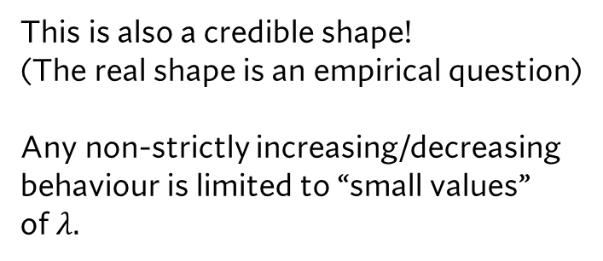
Sketching the CEAC by hand.
Consider the following CE plane with 100 simulated ICERS. Sketch the cost effectiveness acceptability curve
$$ΔC$$
$$λ^{T}=+∞$$
N=10
N=50
$$Pr⁡(CE|λ)$$
$$0.6$$
This is also a credible shape!
(The real shape is an empirical question)
Any non-strictly increasing/decreasing
behaviour is limited to “small values”
of $λ.$
$$ΔE$$
$$0.4$$
N=30
N=10
$$0$$
$$λ$$
Step 3: Connect these points with a curve

Slide 21
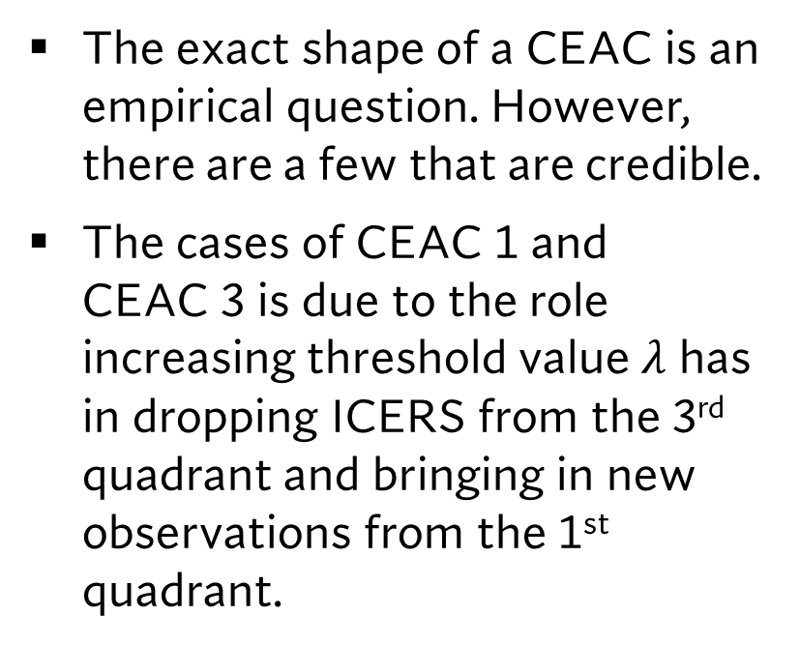
The many shapes of the CEAC
The exact shape of a CEAC is an empirical question. However, there are a few that are credible.
The cases of CEAC 1 and
CEAC 3 is due to the role increasing threshold value $λ$ has in dropping ICERS from the 3rd quadrant and bringing in new observations from the 1st quadrant.
1
CEAC 1
CEAC 2
Probability of Cost Effectivenes $Pr(CE|λ)$
CEAC 3
CEAC 4
0
Threshold Value $λ$

Slide 22
A CEAC Shapes we can never have
Its important to note, that the CEAC will never oscillate or inflect at large threshold values.
This is because these shapes are IMPOSSIBLE based on how the CEAC is computed.
1
CEAC 5
CEAC 6
Probability of Cost Effectivenes $Pr(CE|λ)$
CEAC 7
0
Threshold Value $λ$

Slide 23
Probability Distribution Functions
An Overview

Slide 24

The Need for Distributions
The idea of probabilistic sensitivity analysis is that we will replace fixed parameter values in our model with distributions.
A distribution characterizes a set of values which a parameter may take in a model in question.
A distribution is often described by a measure of middle (such as the mean) and a measure of spread (such as variance/ standard deviation).
SEVERAL CLASSES CAN BE SPENT ON THIS TOPIC AND THERE ARE MORE DISTRIBUTIONS THAN THE ONES DISCUSSED HERE WHICH MAY BE RELEVANT FOR YOUR WORK.

Slide 25
A List of Different Distributions
Distribution | Parameters | Application
Normal | Mean (μ); standard deviation (σ) | Effectiveness, utilities
Beta | α, β | Effectiveness, utilities
Dirichlet | α, β | Effectiveness
Gamma | α, β | Costs, utilities
LogNormal | Mean (μ); standard deviation (σ) | Costs, effectiveness
Weibull | λ, κ | Effectiveness
Gompertz | Υ, λ | Effectiveness
Exponential | λ | Effectiveness

Slide 26
A List of Different Distributions
Distribution | Parameters | Application
Normal | Mean (μ); standard deviation (σ) | Effectiveness, utilities
Beta | α, β | Effectiveness, utilities
Dirichlet | α, β | Effectiveness
Gamma | α, β | Costs, utilities
LogNormal | Mean (μ); standard deviation (σ) | Costs, effectiveness
Weibull | λ, κ | Effectiveness
Gompertz | Υ, λ | Effectiveness
Exponential | λ | Effectiveness

Slide 27
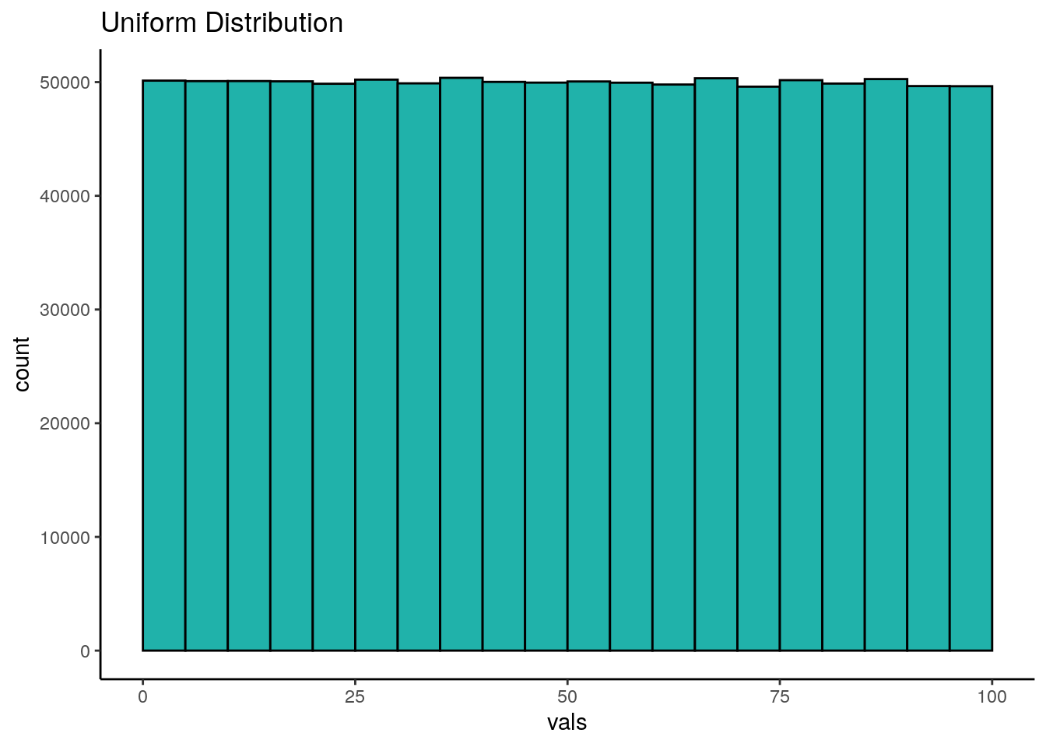
The Uniform Distribution
Each outcome has the same probability.
Examples of Data Generating Processes which follow the Uniform Distribution:
-Dice Roll
-Lottery Numbers
-Drawing a random card from a deck.
It treats the probability of each outcome as equal to eachother.
  -May be a good bun unrealistic place to start when thinking about uncertainty.
  -In excel RAND() generates a random number between 0 and 1, RANDBETWEEN() generates a random number on specific interval.

Slide 28
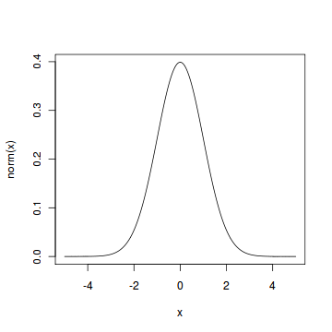
The Normal Distribution
The ideal distribution of data in terms of being able to describe it with both mean and standard deviation alone is the Normal Distribution.
Its symmetric and bell shaped.
Most data is not like this, However, it is use is justified under the CENTRAL LIMIT THEOREM.
The central limit theorem (CLT) states that the distribution of sample means approaches a normal (bell-shaped) distribution as the sample size gets larger, regardless of the shape of the original population's distribution.
This is a natural starting point;However, there are circumstances when we don’t want to use this result.
- For utilities, we have outcomes strictly between 0 and 1. The normal distribution does not limit us to these cases.
In excel the command we care about is NORM.INV().
I.e. A random draw from a normal distribution with a mean of zero and standard deviation of 1 is =NORM.INV(RAND(),1,0).

Slide 29
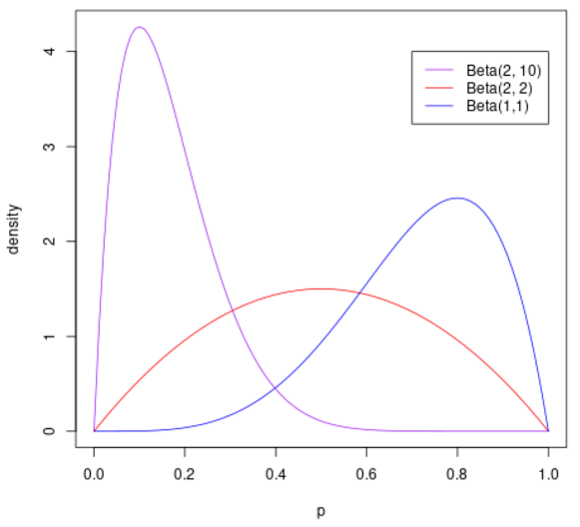
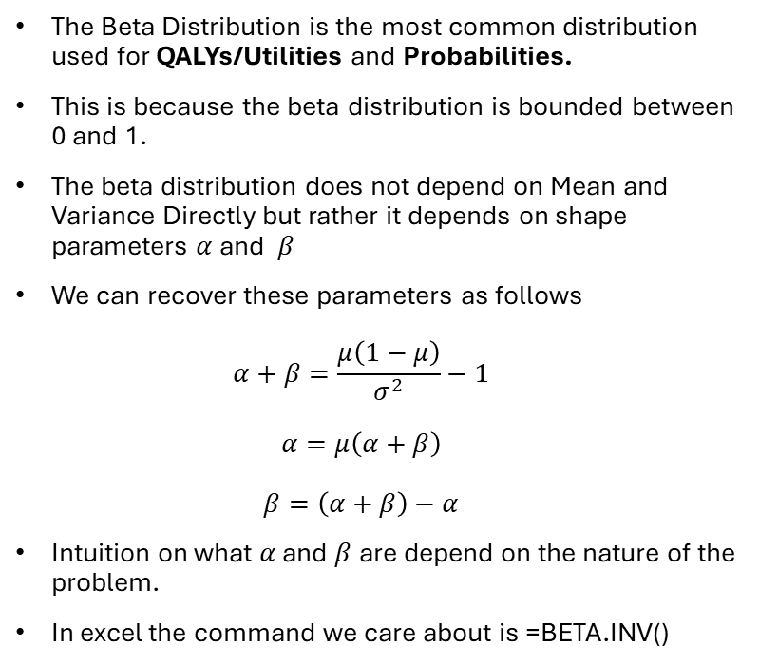
The Beta Distribution
The Beta Distribution is the most common distribution used for QALYs/Utilities and Probabilities.
This is because the beta distribution is bounded between 0 and 1.
The beta distribution does not depend on Mean and Variance Directly but rather it depends on shape parameters $α$ and $β$
We can recover these parameters as follows
$α+β=\frac{μ\left(1−μ\right)}{σ^{2}}−1$
$α=μ\left(α+β\right)$
$β=\left(α+β\right)−α$
Intuition on what $α$ and $β$ are depend on the nature of the problem.
In excel the command we care about is =BETA.INV()

Slide 30
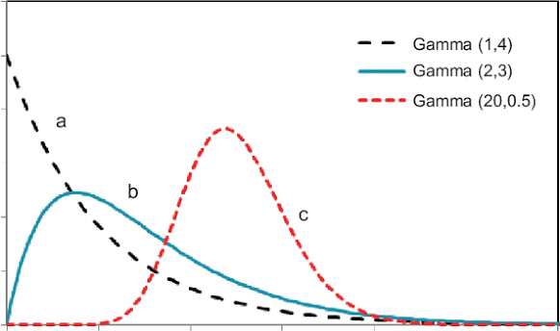
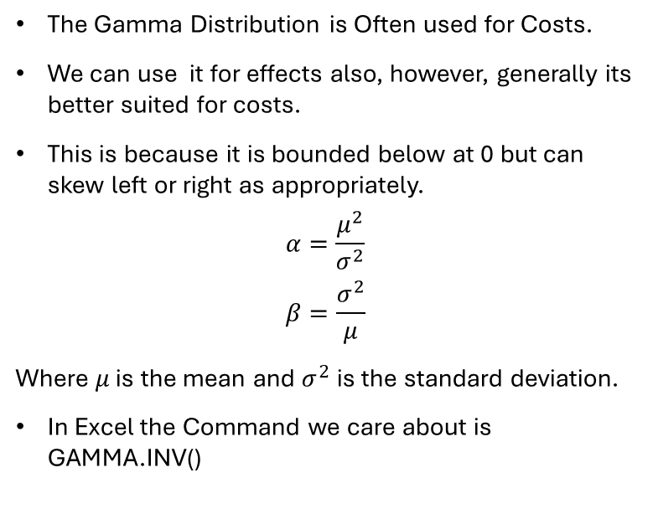
The Gamma Distribution
The Gamma Distribution is Often used for Costs.
We can use it for effects also, however, generally its better suited for costs.
This is because it is bounded below at 0 but can skew left or right as appropriately.
$$α=\frac{μ^{2}}{σ^{2}} \\ β=\frac{σ^{2}}{μ}$$
Where $μ$ is the mean and $σ^{2}$ is the standard deviation.
In Excel the Command we care about is GAMMA.INV()

Slide 31
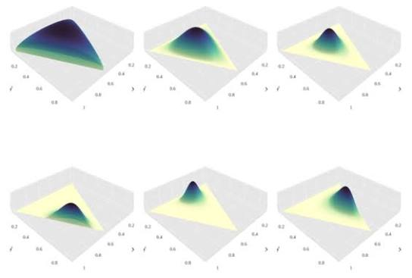
The Dirchlect Distribution
The Dirchlect Distribution is a distribution for multinomial probabilities.
This is useful for probabilities in Markov Models.
Excel does not have a direct distribution but we can construct it with gamma functions.

Slide 32
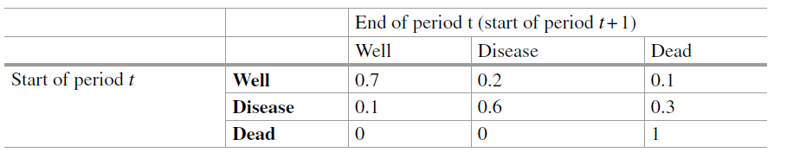

Example
$$P\left(Well | Well\right)=\frac{Gamma\left(70,1\right)}{Gamma\left(70,1\right)+20+10} \\ P\left(Disease | Well\right)=\frac{Gamma\left(20,1\right)}{70+Gamma\left(20,1\right)+10} \\ P\left(Well | Disease\right)=\frac{Gamma\left(10,1\right)}{Gamma\left(10,1\right)+60+30}$$

Slide 33
Conducting a Probabilistic Sensitivity Analysis in Excel
An Application in Excel for Both Decision Trees and Markov Models.

Slide 34
Concluding Remarks.
Probabilistic sensitivity analysis is a powerful tool of testing and pushing the limits on the assumptions behind your model.
Unlike specific deterministic sensitivity analysis, It simulates the values of all parameters at once.
We can easily implement probabilistic sensitivity analysis in excel with carefully tuning our model and using DATA TABLE in Excel.
NEXT CLASS: How do we value diagnostic tests?

